Slide 1
JPA with Hibernate – Quick Example
Raghavendra Balgi

Slide 2
Introduction
This is not a thorough introduction to JPA or Hibernate
It serves as a quick reference who has some familiarity with JPA and needs a quick brush up of the basic concepts
Only the most important annotations and scenarios will be considered
The getters and setters have not been shown for brevity

Slide 3
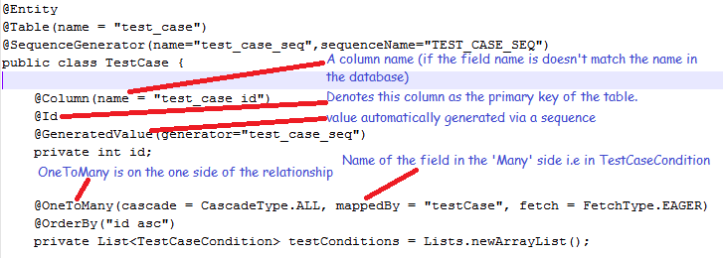
Basics and OneToMany (and ManyToOne)
Every Entity managed by JPA should have a @Entity annotation
It should also have a @Table annotation (and a name attribute if the name of the class doesn’t match the name of the table in the database)

Slide 4
Simple OneToOne
@OneToOne
@JoinColumn(name = “EMP_DPT_ID", referencedColumnName = “DPT_ID")
private Department department;
Here -
The @JoinColumn annotation creates a mapping from one table to another – In this case EMP_DPT_ID column to DPT_ID column in the Department entity

Slide 5

Basics and OneToMany (and ManyToOne)
On the other side of the relationship (i.e. Many side), the ManyToOne annotation is used

Slide 6
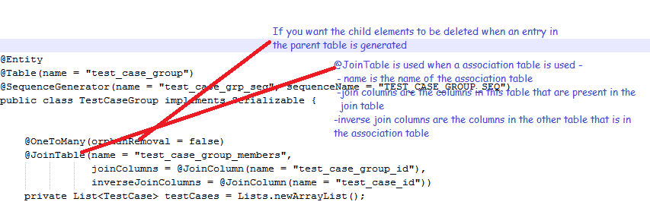
ManyToMany using a JoinTable
A many to many relationship, a association table (or join table) is often used as in the below example

Slide 7
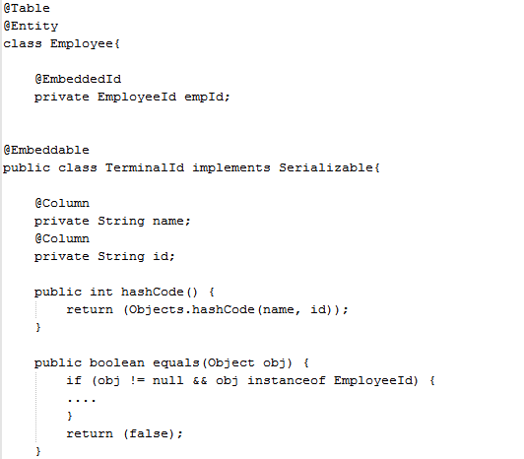
Managing entities with Composite keys
The Employee column has 2 primary keys and so an EmbeddedId annotation is used in lieu of the @Id annotation
Finally, the TerminalId class is created that represents the primary key of the Employee class
Please note that the EmployeeId class has to override the hashCode and equals method

